Slide 1
MAY 8, 2020
CS 327E ELEMENTS OF DATABASES:
PROJECT FINAL PRESENTATION
VAXONOMICS
VEE LEE KOH AND NOAH PLACKE
The University of Texas at Austin

Slide 2
Primary Dataset :
Vaccine Adverse Event Reporting System (VAERS) 2018 by CDC
Adverse Events, Vaccines, and Symptoms
Secondary Dataset :
FDA Adverse Event Reporting System (FAERS) Q4 2018 by FDA
Demographics, Drugs, Reactions, Outcomes, and Diagnosis
Goal of Project :
Investigate if there is correlation between adverse events and attributes of patients, vaccines, drugs, or external factors
PROJECT
OVERVIEW
Notes:
Start off with project overview
VAERS was created to detect adverse events related to a vaccination → contains list of reported adverse events as well as details regarding the vaccine and symptoms experienced, thus the 3 files listed.
FAERS contains information on adverse event and medication reports submitted to FDA – similar to primary but is for drugs → files include …
We want to investigate if there are factors that can be attributed to vaccine and drug related adverse events. Keeping in mind that correlation does not indicate causation, we want to see if there is a high correlation between the adverse effects and attributes of patients/vax/drug/other factors.
For instance, are patients who experience adverse symptoms from a particular age group, state or during a particular time of the year?

Slide 3
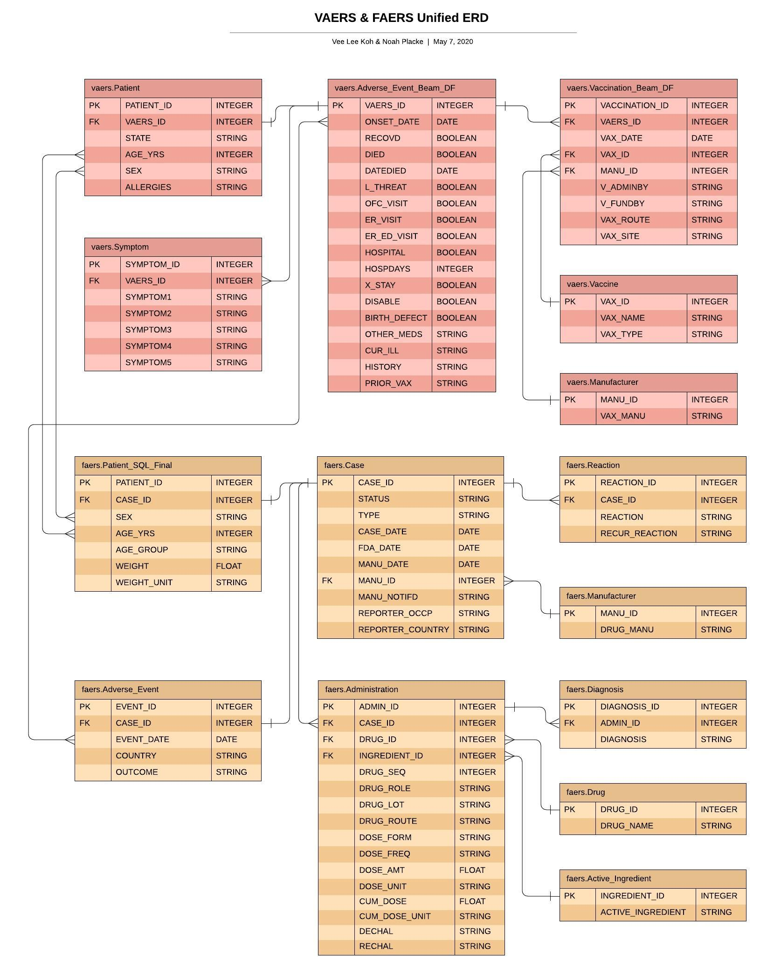
MODELED TABLES
ERD
Notes:
Red → primary, Orange → secondary
VAERS
Patient → Adverse event table for each case → along with symptoms and vaccination which triggered the event → unique vax and manu
FAERS
Patient → Case table with details of each report → Adverse event, Reaction (medical condition after drug), unique manu, Administration (details on administering of drug) → Diagnosis (details of disease), unique drug and active ingredient
PK for most were generated, as no existing id
Both datasets joined using date, sex and age

Slide 4
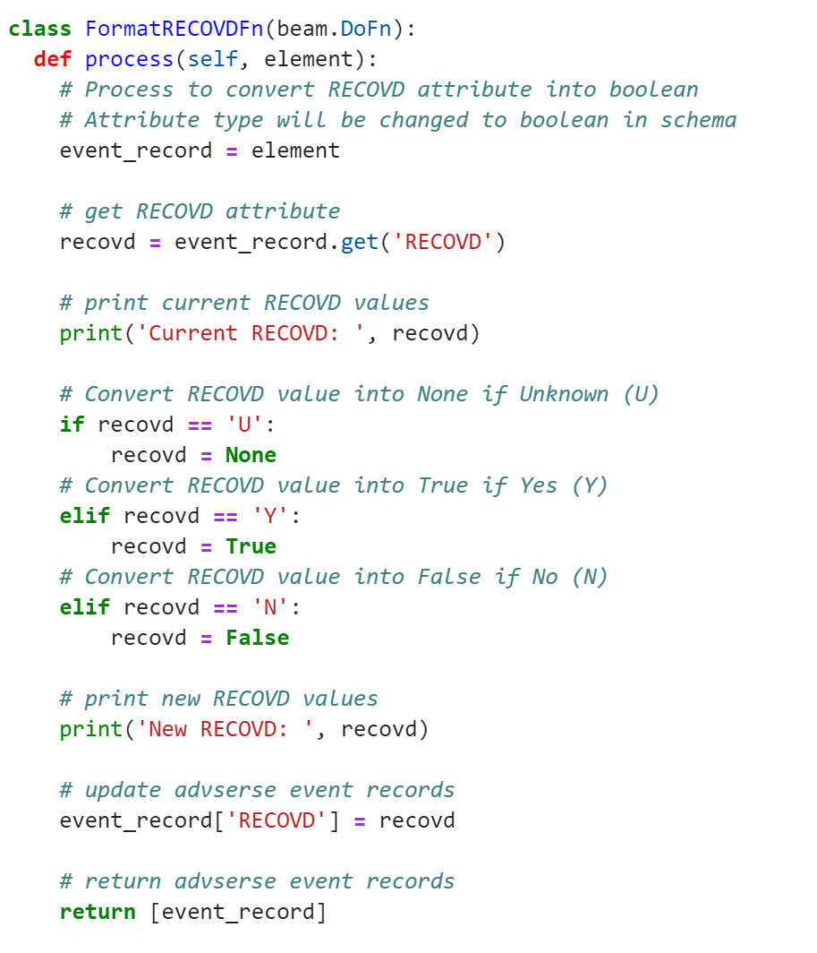
Beam Transforms on VAERS Dataset
Adverse Event Table :
Convert String attributes into Booleans
Recovered and Birth defect
Standardize values of Boolean attributes
Died, Life threatening, Hospitalized, ER visit, Disabled, etc.
Vaccination Table :
Standardize unknown values of String attributes
ParDo Transform for ‘Recovered’ attribute
Notes:
Moving on to beam transforms
In Adverse_Event table, attributes RECOVD and BIRTH_DEFECT are of type STRING, but would be more suitable as BOOLEAN.
On the right, snippet of pardo transform → In RECOVD, 'Y’ = True, 'N’ = False, and 'U’ = None
Same logic applied was applied on birth defect
We also standardized values of Boolean attributes listed → either True or null, so null converted to False
These attributes are as shown (DIED, L_THREAT, OFC_VISIT, ER_VISIT, ER_ED_VISIT, HOSPITAL, X_STAY and DISABLE)
For Vaccination table, we standardized unknown values of string attributes → some attributes have either null or 'UN' (Unknown) as values → they were converted to 'UN’.
V_FUNDBY, VAX_ROUTE and VAX_SITE

Slide 5
SQL Transforms on FAERS Dataset
Patient Table :
Standardize age values into a single unit
Intermediate tables : Convert decades, months, weeks, days, and hours into years
Final table : Union all tables
Check if all records retained
Notes:
For secondary dataset we performed SQL transforms
In patient entity, age values were in multiple units (decade, year, month, week, day, hour) → converted them into a single unit
Used intermediate tables to standardize all of them into years
Unioned all of them into a final table + check if all records retained
Live demo

Slide 6
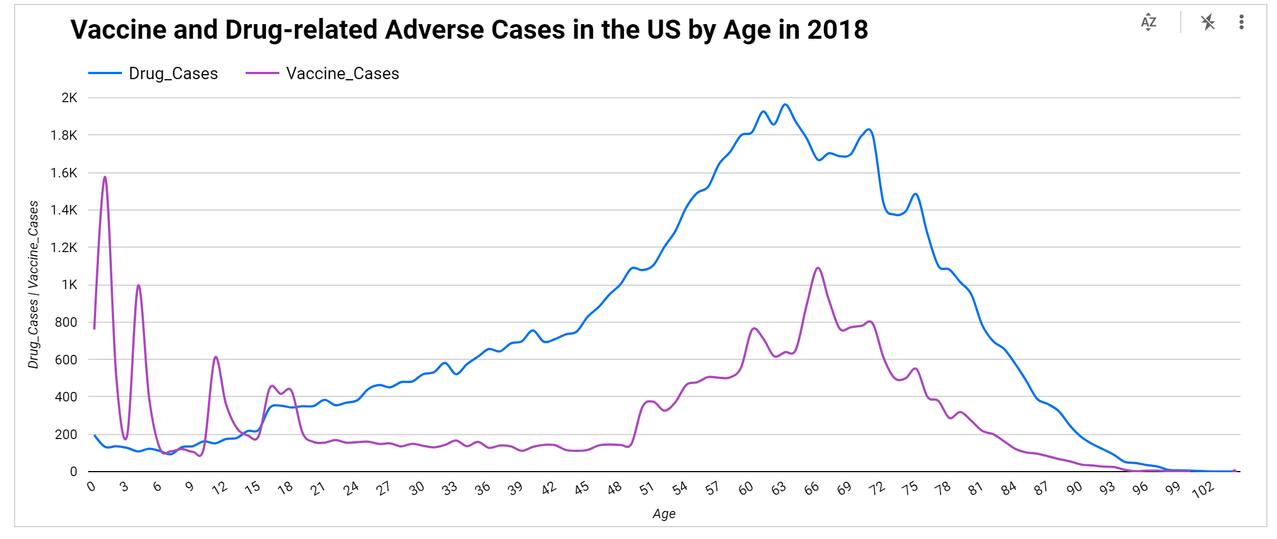
Cross - Dataset Queries
Joining Datasets :
Full Outer Join : Vaccine and drug-related adverse events by age
Inner Join : Adverse events, deaths and hospitalizations by month
Inner Join : Adverse events, deaths and hospitalizations by gender
Notes:
Explain the three joins
First join - outer join because of different age ranges of both datasets
Chart 1: Vax cases more prominent in earlier ages, particularly infants and preschoolers; drug cases more prominent for individuals in 60s; local maxima for vax cases in 60s too

Slide 7
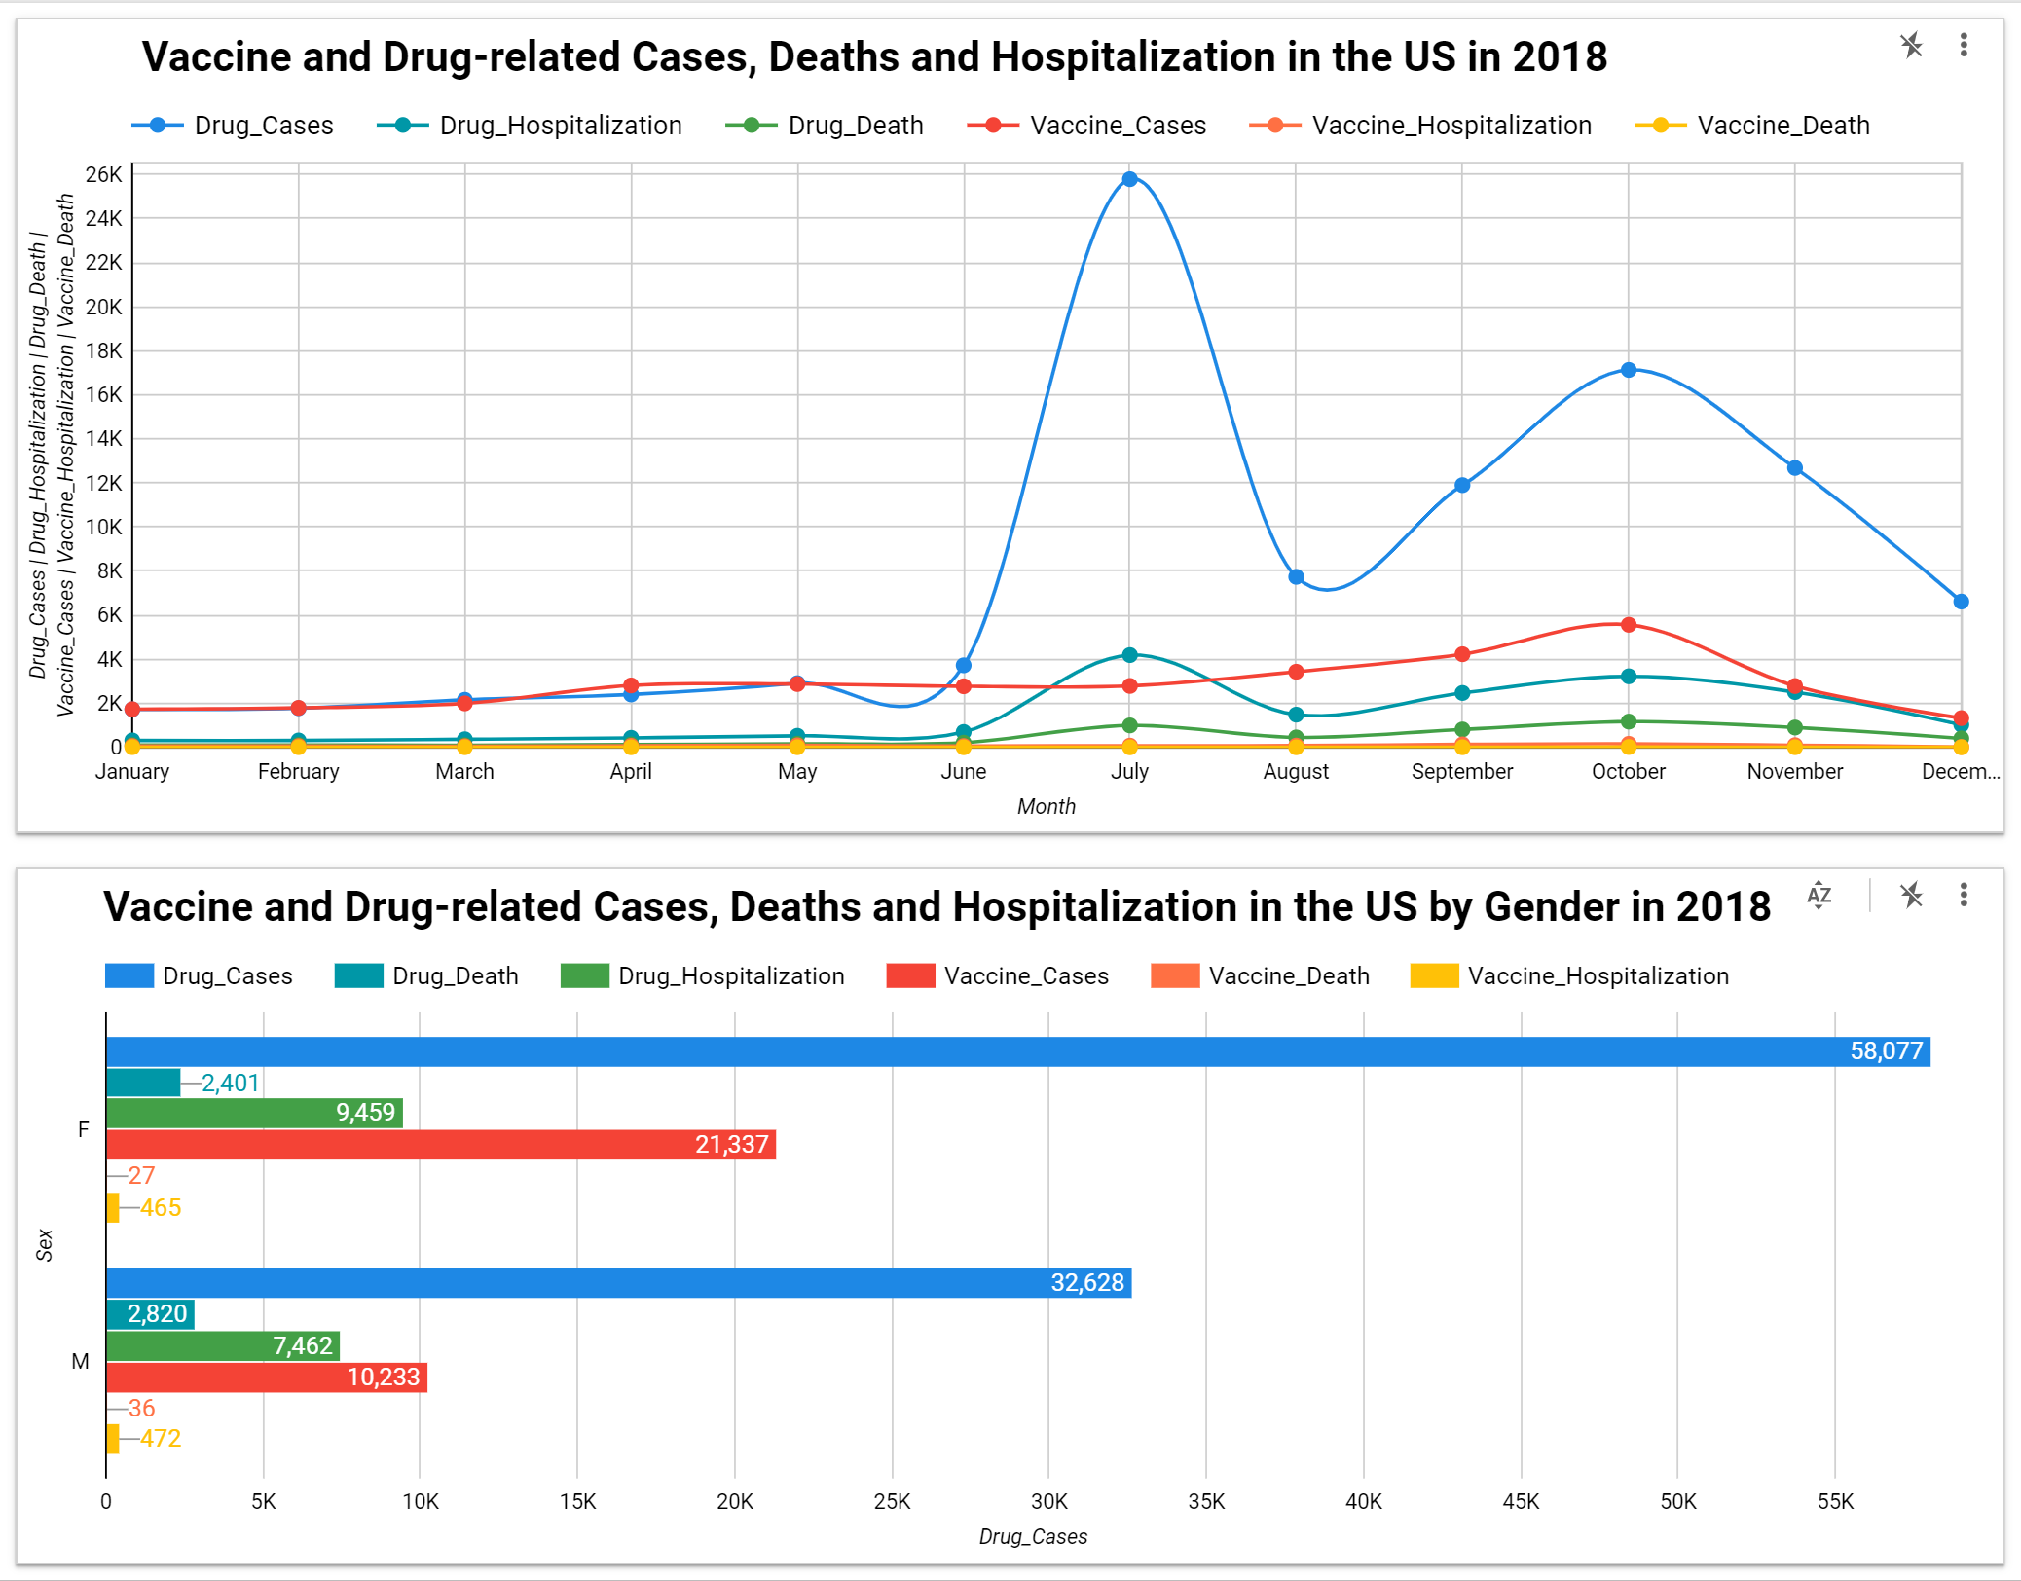
CROSS -DATASET VISUALS
Notes:
Chart 2:
Shades of blue/green → drug; shades of red → vax
Drug highest in July
Vax highest in Oct – could be higher vax due in prep for flu season
Chart 3
Higher cases for females across the board – drug and vax

Slide 8
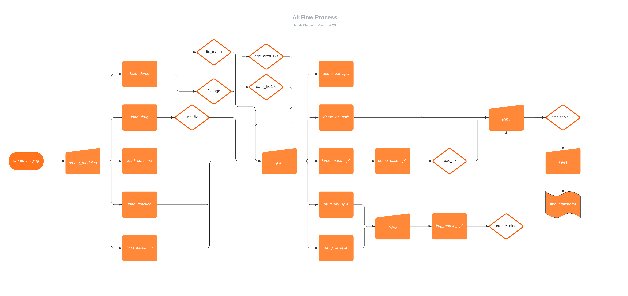
Airflow DAG

Slide 9
Future Improvements to Solution
Data Required for Better Solution :
Residential states of patients → Assess insurance coverage & healthcare quality by state
Disease data → Join datasets by disease and count adverse events
Standardize manufacturer names → Join datasets by manufacturer

Slide 10
THANK YOU!

